Slide 1


Exploratory Data Analysis: basic data set exploration

Slide 2

1. Shape (dimension) of the dataframe
2. Data types of the various columns
observe that our dataset has a combination of categorical (object) and numeric (float and int) features.
Numeric features that should be categorical and vice versa
3. Display a few rows
Can you understand the column names? Do they make sense? (Check with the variable definitions again if needed)
Do the values in these columns make sense?
Are there significant missing values (NaN) sighted?
What types of classes do the categorical features have?

Slide 3
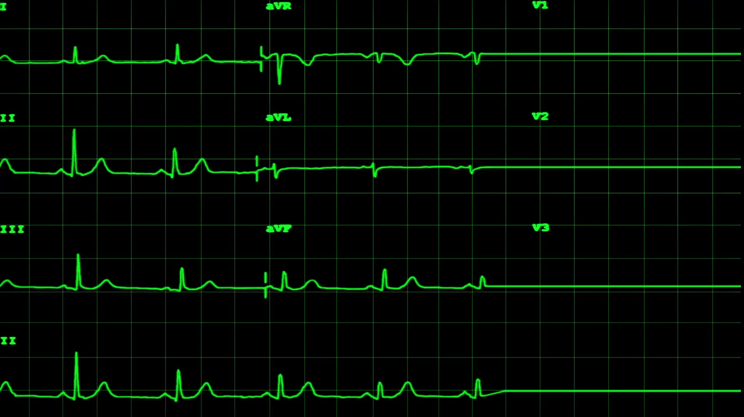
4. Distribution:
How the values in a feature are distributed, or how often they occur. For numeric features, we’ll see how many times groups of numbers appear in a particular column, and for categorical features, the classes for each column and their frequency. We will use both graphs and actual summary statistics. The graphs enable us to get an overall idea of the distributions while the statistics give us factual numbers. These two strategies are both recommended as they complement each other.

Slide 4
Numeric features
5. Plot each numeric feature
Possible outliers that cannot be explained or might be measurement errors
Numeric features that should be categorical. For example, Gender represented by 1 and 0.
Boundaries that do not make sense such as percentage values> 100.
6. Summary statistics of the numerical features
Describe

Slide 5
Categorical features
7. Summary statistics of the categorical features
it is important to show the summary statistics before we plot graphs because some features have a lot of unique classes (like we will see for the Address) and the classes would be unreadable if visualized on a countplot.
get the count of the values of each feature, the number of unique classes, the topmost frequent class, and how frequently that class occurs in the data set.
Countplot: histogram for categorical variables
What to look out for:
Sparse classes which have the potential to affect a model’s performance.
Mistakes in labeling of the classes, for example 2 exact classes with minor spelling differences.

Slide 6
Grouping and Segmentation
Segmentation allows us to cut the data and observe the relationship between categorical and numeric features.
8. Segment the target variable by categorical features.
Compare the target feature between the various classes of the main categorical features and see how the target changes with the classes.
Boxplot
What to look out for: which classes most affect the target variables.
9. Group numeric features by each categorical feature.
How other numeric features change with each categorical feature by summarizing the numeric features across the classes.
groupby
Notes:
groupby function to group the data by a category and calculate a metric (such as mean, median, min, std, etc) across the various numeric features.

Slide 7
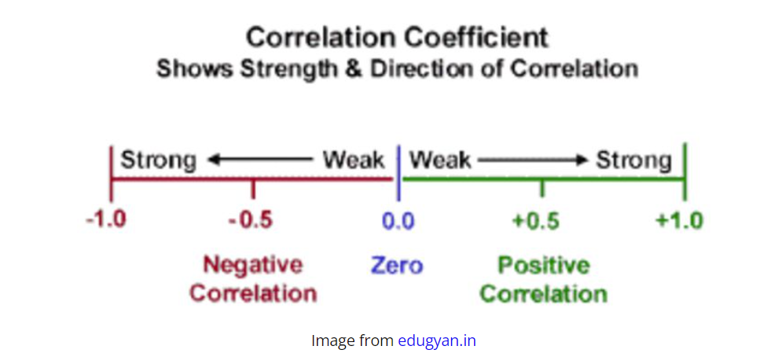
Relationships between numeric features and other numeric features
10. Correlation matrix for the different numerical features.
A correlation is a value between -1 and 1 that amounts to how closely values of two separate features move simultaneously. A positive correlation means that as one feature increases the other one also increases, while a negative correlation means one feature increases as the other decreases. Correlations close to 0 indicate a weak relationship while closer to -1 or 1 signifies a strong relationship.

Slide 8
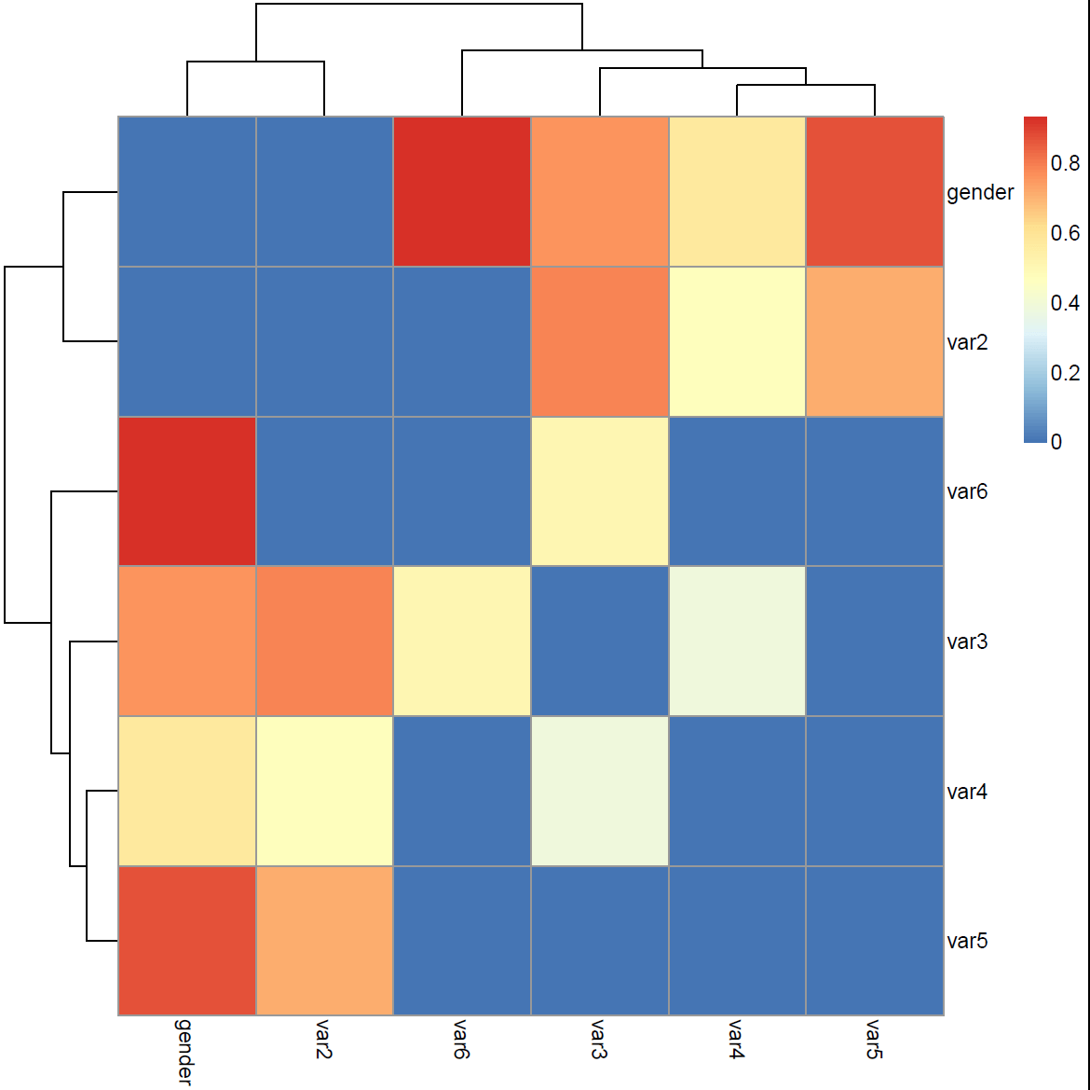
11. Heatmap of the correlations
A high positive correlation appears as dark red and a high negative correlation as dark blue. Closer to white signifies a weak relationship.
What to look out for:
Strongly correlated features; either dark red (positive) or dark blue(negative).
Target variable; If it has strong positive or negative relationships with other features.

